Slide 1
INTELLIGENT ALERT SYSTEM FOR FOREST TRIBAL PEOPLE USING IBM WATSON STUDIO

Slide 2
Introduction:
Intelligent Alert System for Forest Tribal People Using IBM Watson Studio. This project aims to save the lives of tribal by notifying about wildlife predation with the help of Artificial Intelligence.
Tribal people constitute 8.6% of the nation's total population, and most of them spend the greater part of their lives in the proximity of trees and villages or clans near to the forest. There are so many challenges faced by these people out of which Human-wildlife conflict is a serious challenge undermining the protection of tribal regions. The major types of human-wildlife conflict in the area include crop-raiding, livestock predation, increased risk of livestock diseases, and direct threats to human life. so Active measures are to be implemented to mitigate these problems and safeguard the future of the wildlife. Hence we came up with this Project “Intelligent Alert System”. This ensures the complete safety of humans who lives near the forests by notifying the wild animal predation before it enter the clan.

Slide 3
Overview:
Dataset Collection
Image Pre Processing
Model Building
Video Analysis
Train CNN Model on IBM
Purpose:
Tribal people constitute 8.6% of the nation's total population, and most of them
spend the greater part of their lives in the proximity of trees and villages or clans
near to the forest.
There are so many challenges faced by these people out of which Human-wildlife
conflict is a serious challenge undermining the protection of tribal regions.
The major types of human-wildlife conflict in the area include crop-raiding,
livestock predation, increased risk of livestock diseases, and direct threats to
human life.
Hence we came up with this Project “Intelligent Alert System”. This ensures the
complete safety of humans who lives near the forests by notifying the wild
animal predation before it enters the clan.

Slide 4
Literature Survey:
Existing problem:
Agriculture is the most important sector of Indian Economy but the issue of damage to crops by wild creatures has turned into a noteworthy social issue in current occasions. So far there is no effective solution to this problem and therefore requires earnest consideration. This project provides a smart solution to resolve this problem. In this framework, image is captured when an animal intrudes and then image is classified as domestic or wild animal using Convolution Neural Network (CNN) and deep learning technique. This classification helps in alerting the farmer by alerting in case of intrusion of wild animal. The smart farm protection system gives reliable security and safety to crops. This system guarantees the wellbeing of creatures while warding them off It likewise diminishes the exertion made by man in securing the field and All the tribal populations of India were traditionally closely associated with forests, and there are some who even today spend the greater part of their lives in the proximity of trees and villages or clans near to forest. If any dangerous predators when entered into a village or clan may lead to loss of resources or in extreme cases leads to loss of life. Here we come up with an artificial intelligence based technique which detects the animals before its gets enter into villages.

Slide 5
Proposed Solution:
The whole system can be divided in to three main part1. Animal classification and recognition from real time video.2. Alarm unit A. Real time Animal classification and recognition en the literature large amount of approaches have been proposed to accomplish the task of animal recognition that has different aims, strengths and limitations. Here new approach called "Transfer learning" is used for animal detection and recognition. Before going deep in to transfer learning need to know about neural network and Convolutional Neural Network. Pooling Layer, and Fully-Connected Layer. Stacking of these layers gives a full1) Convolutional neural network. A simple CNN is a sequence of layers. It mainly uses three main types of layers to build CNN architectures. That are Convolutional Layer, Convolutional neural network architecture. a) Convolutional Layer: The Convolution layer is the core building block of CNN that does most of the computations. The Convolution layer consist of a set of learnable filters Every filter is small spatially (along width and height), but extends through the full depth of the input volume. For example, a typical filter on a first layer of a Convolution layer might have size 3 x 3 x 3 (i.e. 3 pixels width and height, and 3 colour channels). We convolve by sliding each filter across the width and height of the input volume and compute dot products between the filter coefficient.

Slide 6
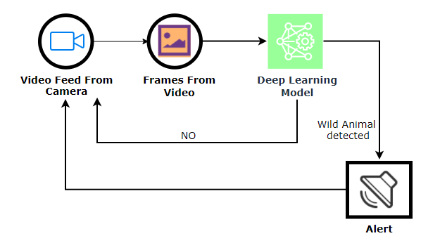
Theoritical Analysis:
Block diagram

Slide 7
Hardware /software designing
This project involves the followings software packages
Anaconda
VS code
Jupyter IDE
Tensorflow
Keras
Layersopen cv
CNN
Twilio

Slide 8
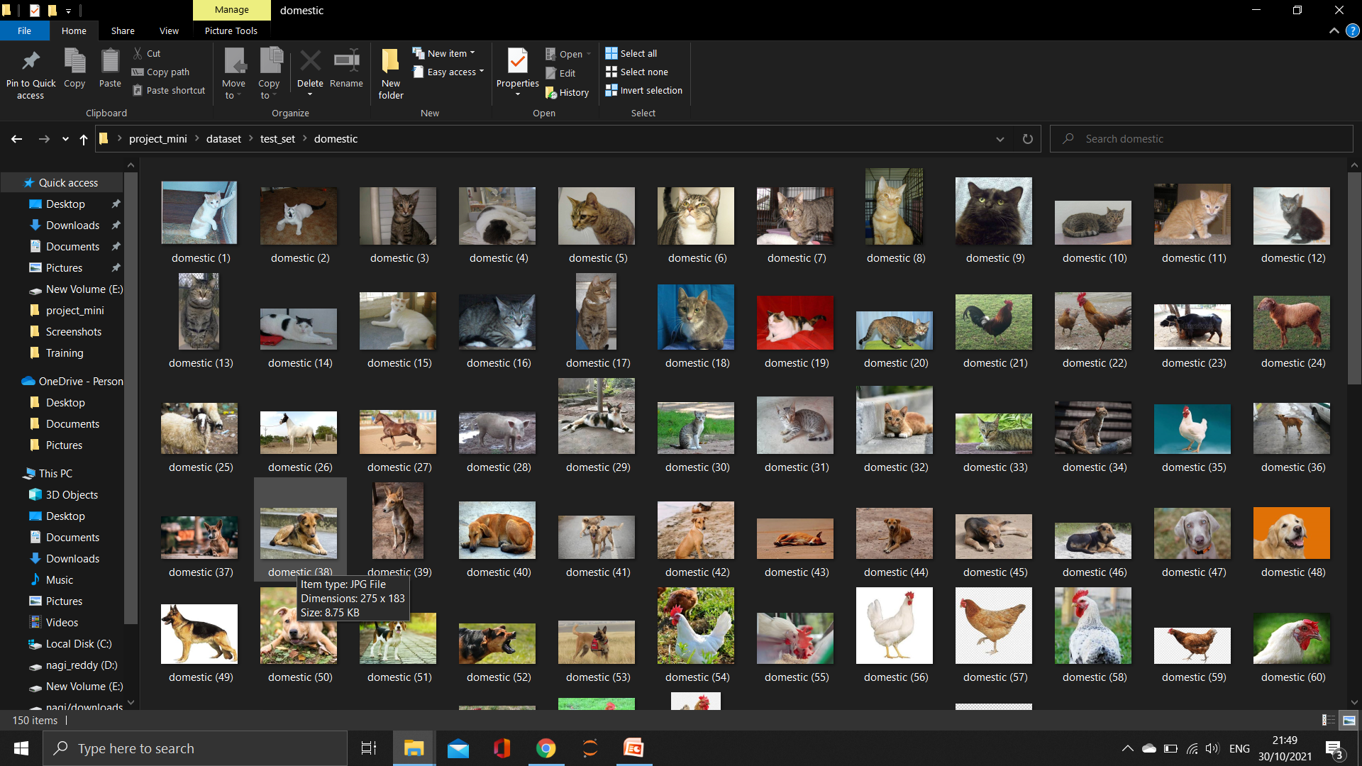
Experimental Investigation

Slide 9
Flow chart
Start
Dataset collection
Image pre processing
Model Building
Video Analysis
Train model on IBM
End

Slide 10
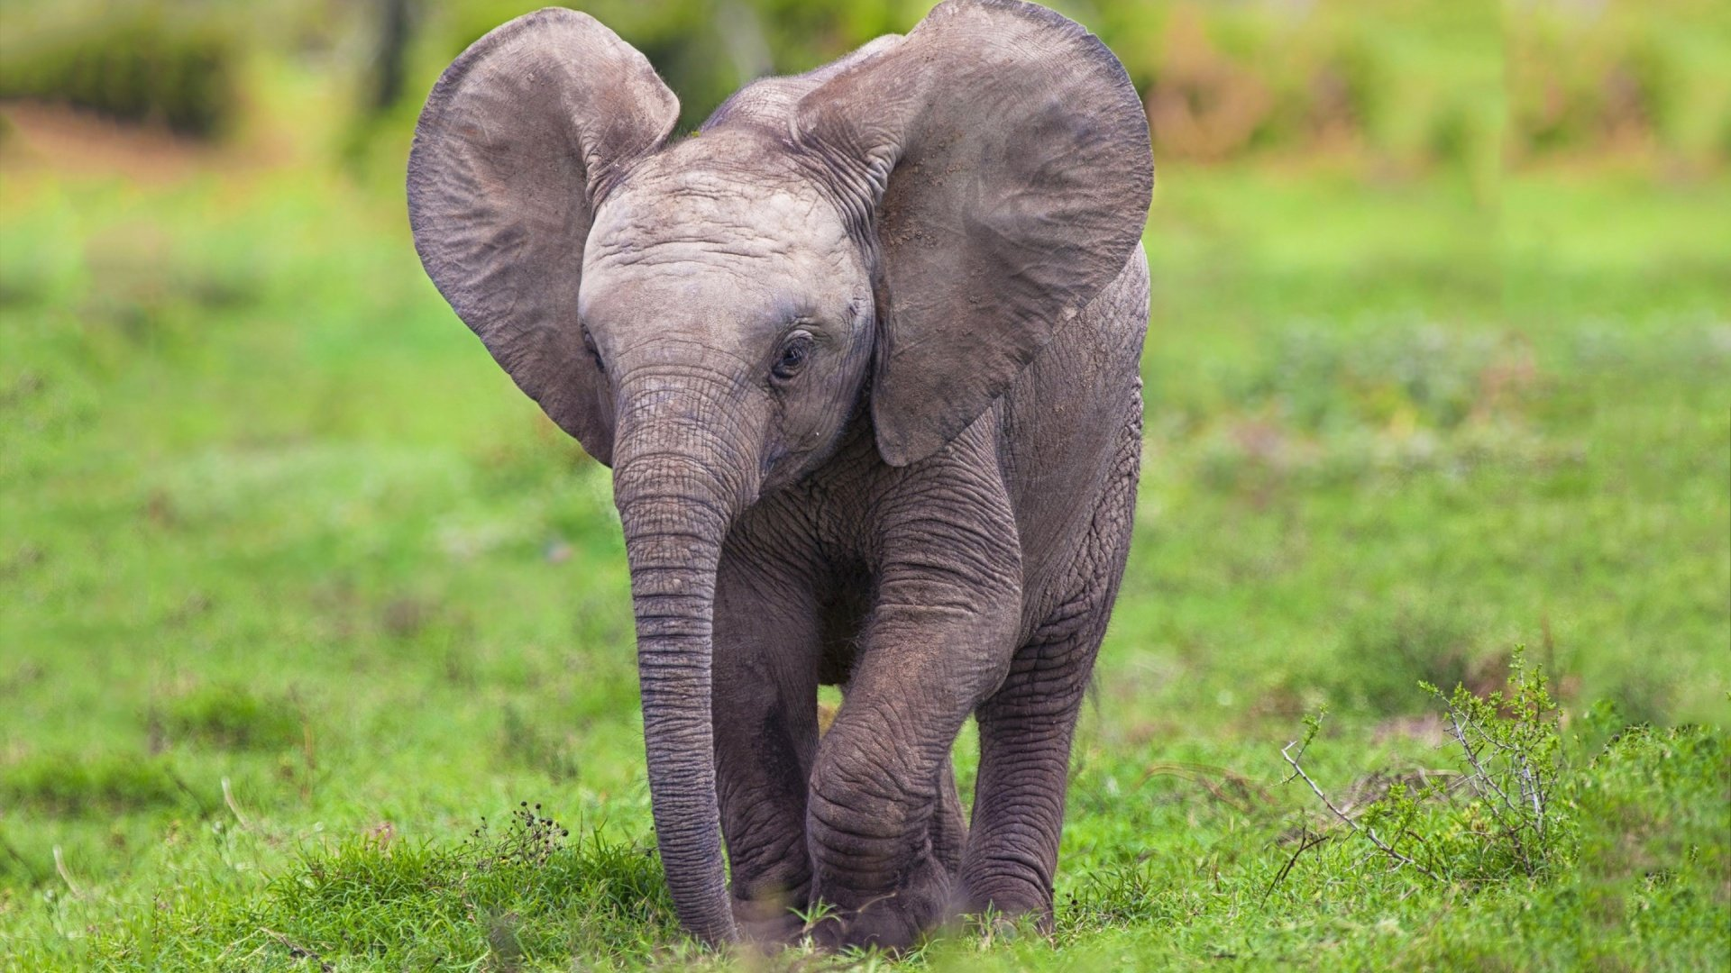
Result
As the first step datasets are collected. We know that the image taken from the cameras in the forest contain animal coming in different orientation. So the system should detect animal in any orientation. Data augmentation is performed for each images.

Slide 11
Advantages :
Features are automatically deduced and optimally tuned for desired outcome. Features are not required to be extracted ahead of time
The same neural network based approach can be applied to many different application and data type.
Disadvantages:
Screen is difficult to read in low light or bright sunlight
Keeping track of cameras and images (no meta-data)
Losing settings during transit
Walk-by test requires downloading image on laptop in the field

Slide 12
Applications:
Automatically Adding Sounds To Silent Movies
Automatic Machine Translation
Object Classification and Detection in Photographs
Automatic Handwriting Generation
Character Text Generation
Image Caption Generation
Automatic Game Playing.
Conclusion:
The paper discusses in detail all advances in the area of automated wildlife monitoring. Animal detection methods are very useful for many real time applications. Automated animal detection, localization, and species recognition lie in the heart of automated camera-trap image analysis. Animal detection approaches are helpful to prevent dangerous situations caused by the wild animals in residential area. Detection of animal in the border region helps the people living in the border region to take safety precaution. Hence this system ensure the security of both wild animal and human beings in the border region.

Slide 13
Feature scope:
This work can be further extended by sending an alert in the form of a message when the animal is detected to the nearby forest office. Furthermore it can be used to reduce human wildlife conflict and also animal accidents. References

Slide 14
Bibilography:
Baraldi, A., & Parmiggiani, F. (1995). An investigation of the textural char acteristics associated with gray level cooccurrence matrix statistical parameters. Geoscience and Remote Sensing, IEEE Transactions on, 33, 293-304. https://doi.org/10.1109/36.377929

